Slide 1


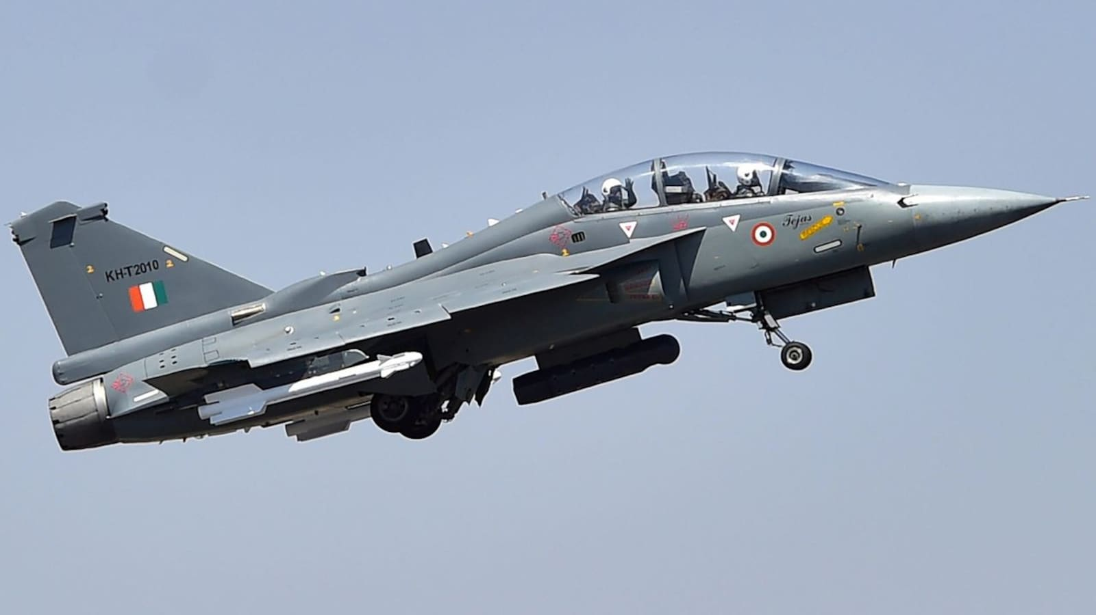

A
Internship Presentation On
“Nonlinear 6-DOF Dynamic RCAM Model”
By
HARSHA S 1GV20EC011
NAVEEN KUMAR N 1GV20EC024
SHASHANK C 1GV20EC032
NAYAN KUMAR K 1GV21EC401
Date: 26/05/2024
Carried out at
HAL LCA Tejas Division
Under the guidance of,
External Guide Internal Guide
Artika Upadhyay Dr. K M Palaniswamy
Chief Manager (HR), Professor, Dept. of ECE
HAL LCA Teajs Dr. TTIT, KGF.
Department of ECE
Dr.TTIT, KGF

Slide 2
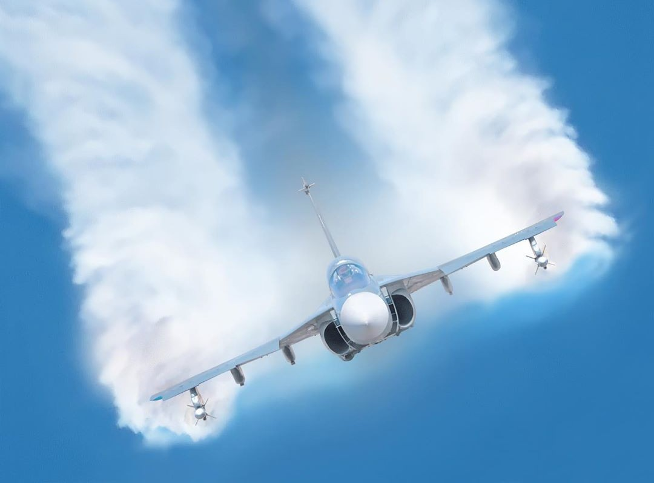
CONTENTS
Application
System Implementation
RCAM Simulink Module
Input & Output Waveforms
Conclusion
About company
Vision & Mission
General characteristics
Systems of LCA Tejas
Fuselage Assembly
Drop tanks

Slide 3
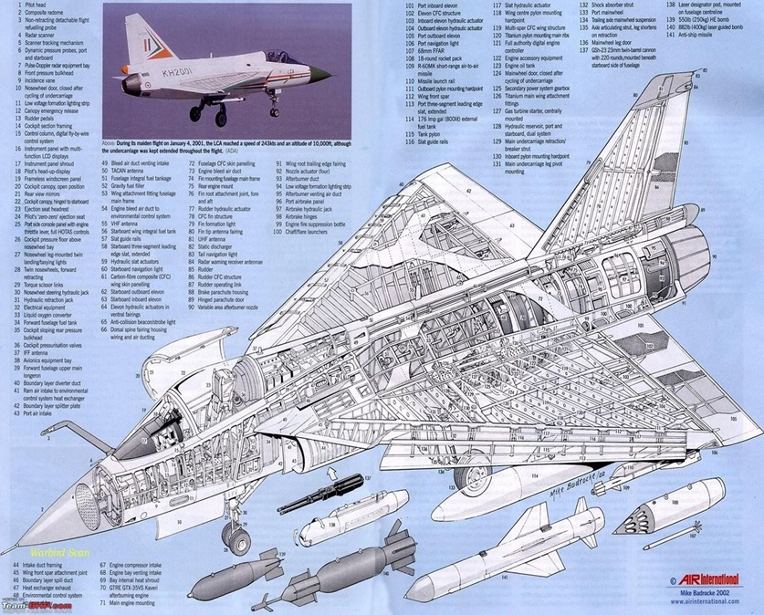



Slide 4
Introduction about LCA-Tejas
Nonlinear 6-DOF Dynamic RCAM Model
2023-2024
LCA –Tejas division was designed by Sri. Kota Harinarayan in the 1980s to replace India's ageing MiG-21 fighters.
In 2003, the LCA was officially named as “Tejas” by Former Prime Minister of India Atal Bihari Vajpayee.
The Tejas is the second supersonic fighter developed by Hindustan Aeronautics Limited (HAL).
The TEJAS has fly-by-wire system with redundant relative static stability.
8th SEM DEPT OF ECE DR TTIT, KGF

Slide 5
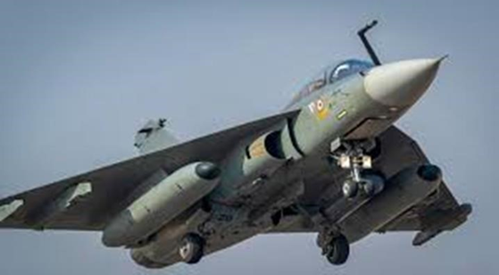
Vision
Nonlinear 6-DOF Dynamic RCAM Model
2023-2024
“To be a global leader in the Aerospace & Defense Industry”.
Mission
We are committed to deliver superior technology solutions to the customers by leveraging our infrastructure and Design, Manufacture & Service skills, for achieving business excellence.
8th SEM DEPT OF ECE DR TTIT, KGF

Slide 6
Nonlinear 6-DOF Dynamic RCAM Model
2023-2024
General Characteristics
Length: 13.20 m (43 ft), Wingspan:8.20 m (26 ft), Height: 4.40 m (14 ft)
Maximum speed: Mach 1.8 (2,205 km/h)
Wing area: 413 ft.
Loaded weight: 9,800 kg
Internal fuel capacity: 2,458 kg
Power plant: 1 x General Electric F404-GE-IN20 turbofan
Maximum Altitude :15km
8th SEM DEPT OF ECE DR TTIT, KGF

Slide 7
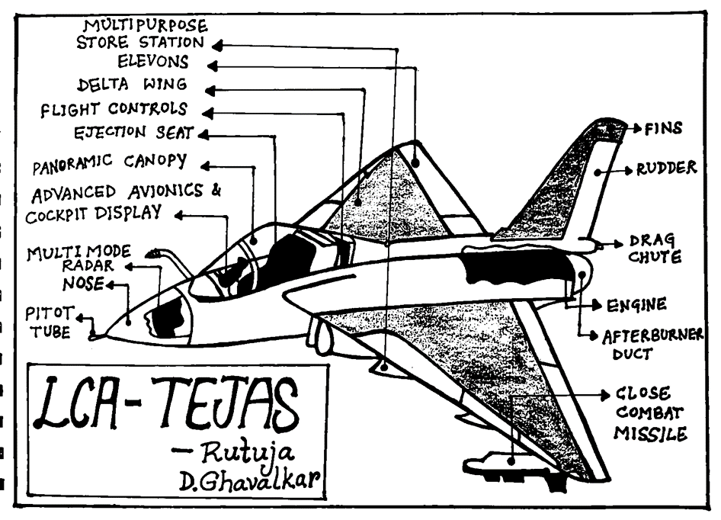



Nonlinear 6-DOF Dynamic RCAM Model
2023-2024
Systems of LCA Tejas
Power plant and Fuel System(PFS)
Electrical and Avionics Systems
Seat and Safety
Flight Control System
Hydraulics System
Environment Control System
8th SEM DEPT OF ECE DR TTIT, KGF

Slide 8
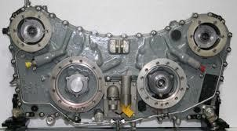
Nonlinear 6-DOF Dynamic RCAM Model
2023-2024
1. Power Plant and Fuel system
The aircraft has 4 main internal fuel tanks
Fuel tank F1 and F2 have a combined capacity of 798 kg of fuel. The F1/2 tank is combined and they are present in the Centre fuselage.
The FIA tank is present behind the cockpit and has a capacity of 436 kg.
The LH and RH wing contain tanks which capacity of 612 kg of fuel each.
The 4 internal fuel tanks combined have a capacity of 2458 kg of fuel.
The maximum fuel capacity of the aircraft including drop tanks is 4330 kg of fuel .
AMAGB
8th SEM DEPT OF ECE DR TTIT, KGF

Slide 9
Nonlinear 6-DOF Dynamic RCAM Model
2023-2024
Components of F1 bottom tank:
Main booster pump (BP1)-electrically operated.
Standby booster pump (BP2)-hydraulically operated.
DC starting pump-Supplies fuel to the Jet Fuel Starter (JFS).
Defueling selector valve.
Fuel drain valve
Water drain valve
There are 5 transfer circuits, 1 for each drop tank, 1 for the FIA tank and 1 for the LH, RH wing tanks
The Transfer Cum Refueling Valve (TCRV)
The FNAV or the Fuel No Air Valve
Air No Fuel Valve (ANFV)
Surge Relief Valve (SRV)
Jet Fuel Starter (JFS)
8th SEM DEPT OF ECE DR TTIT, KGF

Slide 10
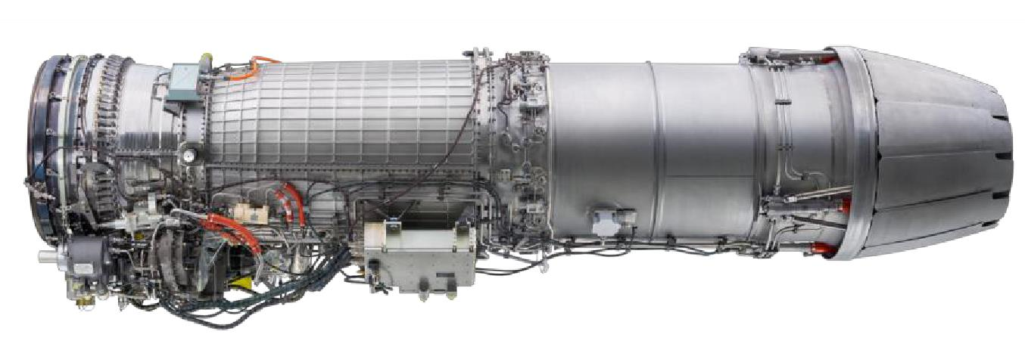
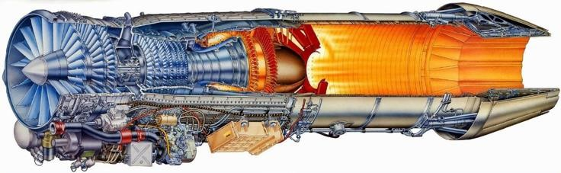
Nonlinear 6-DOF Dynamic RCAM Model
2023-2024
GE-F404 –IN20 is divided into 6 modules:
Fan module
Compressor module
HP turbine module
LP turbine module
Combustor module
After burner module
8th SEM DEPT OF ECE DR TTIT, KGF

Slide 11
2. Electrical System
Nonlinear 6-DOF Dynamic RCAM Model
2023-2024
The electrical system consists of:
1. Integrated Drive Generator (IDG) 30-40 KVA
2. 5KVA Hydraulic Motor Driven Generator (HMDG)
3. 5KW DC Generator
4. Two Nickel Cadmium Batteries
5. Two Transformer Rectifier Units (TRU)
Generators in the Aircraft:
1. AC Generating system:
2. DC Generating System:
8th SEM DEPT OF ECE DR TTIT, KGF

Slide 12
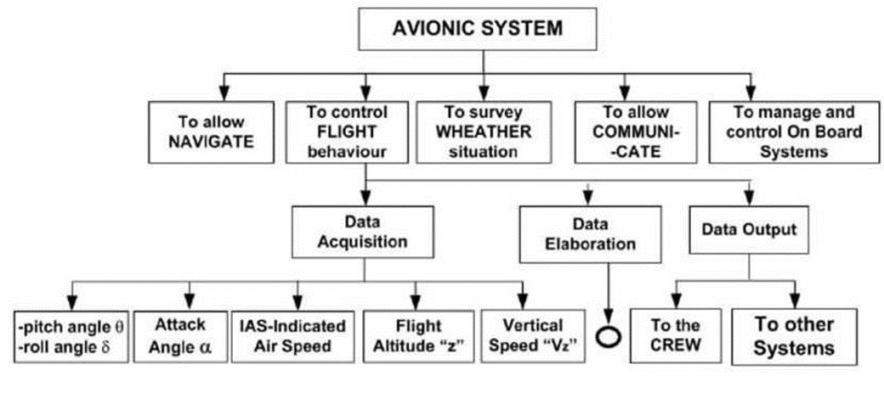
Nonlinear 6-DOF Dynamic RCAM Model
2023-2024
2. AVIONICS SYSTEM
8th SEM DEPT OF ECE DR TTIT, KGF

Slide 13
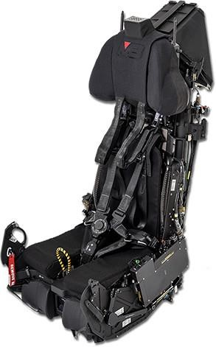
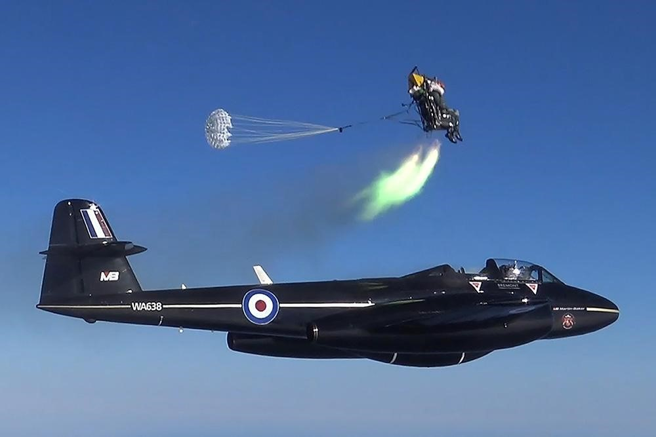
3. Seat and Safety:
Nonlinear 6-DOF Dynamic RCAM Model
2023-2024
Specifications:
Operating Ceiling:55,013ft (16,768m)
Minimum height/Speed: Zero/zero in near level attitude Crew boarding mass range: 61.0 to 133.5 kg
Crew size range: Eurofighter-specific crew size range Maximum Speed for ejection: 600 KIAS
8th SEM DEPT OF ECE DR TTIT, KGF

Slide 14
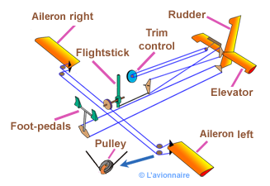
Nonlinear 6-DOF Dynamic RCAM Model
2023-2024
4. FLIGHT CONTROL SYSTEM
Air Data System Control system
The Air Data System consists of:
Nose Air Data Probe(NADP)
Side Air Data Probe(SADP)
Angle of Attack Probe (AOAP)
Angle of Sideslip Sensor (AOSS)
Total Temperature Probe (TOTP)
8th SEM DEPT OF ECE DR TTIT, KGF

Slide 15
5.Hydraulic System
Nonlinear 6-DOF Dynamic RCAM Model
2023-2024
The different systems operated by hydraulic power are:
Primary flight control actuators of in-board elevons, outboard elevons and rudder
Two Hydraulic Motor Driven Generators (HMDG 1 and 2) supply independent electrical power to Flight Control System (FCS).
1.Primary Pump 2. Engine Driven PUMP
Specifications: Specification:
* RPM-6000 * RPM-4500
* Flow-110 Liters/minute * Flow-30 Liters/minute
* Pressure output 280 Bar (4060 Psi) * Pressure output 260 Bar (3770 Psi)
8th SEM DEPT OF ECE DR TTIT, KGF

Slide 16
Nonlinear 6-DOF Dynamic RCAM Model
2023-2024
6. Environmental Control System (ECS)
The Environmental Control System (ECS) provides air supply, temperature control, aircraft cooling and cabin pressurization for the pilot. Avionics cooling, smoke detection, fire suppression are also some tasks carried out by the aircraft's ECS
The tasks carried out by ECS are:
1.Air conditioning of cockpit
2.Cabin scaling
3.Radar cooling
4.Radar pressurization
5.De-mist system
6.Fuel tank pressurization
8th SEM DEPT OF ECE DR TTIT, KGF

Slide 17
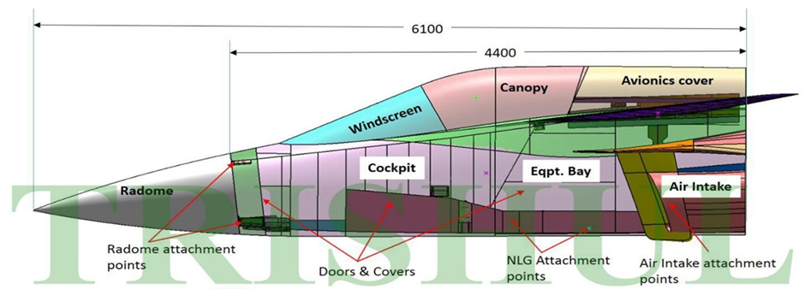
FUSELAGES ASSEMBLY Front fuselage
Nonlinear 6-DOF Dynamic RCAM Model
2023-2024
8th SEM DEPT OF ECE DR TTIT, KGF

Slide 18
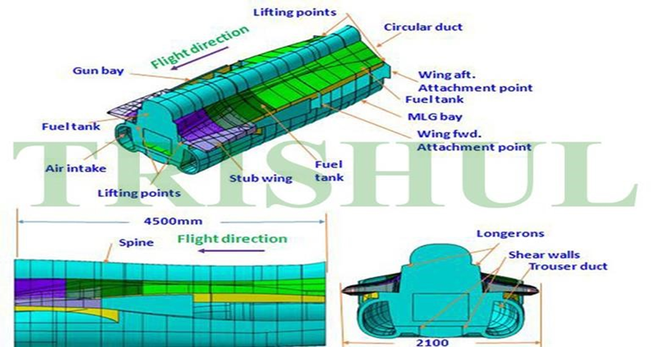
Centre fuselage
Nonlinear 6-DOF Dynamic RCAM Model
2023-2024
8th SEM DEPT OF ECE DR TTIT, KGF

Slide 19
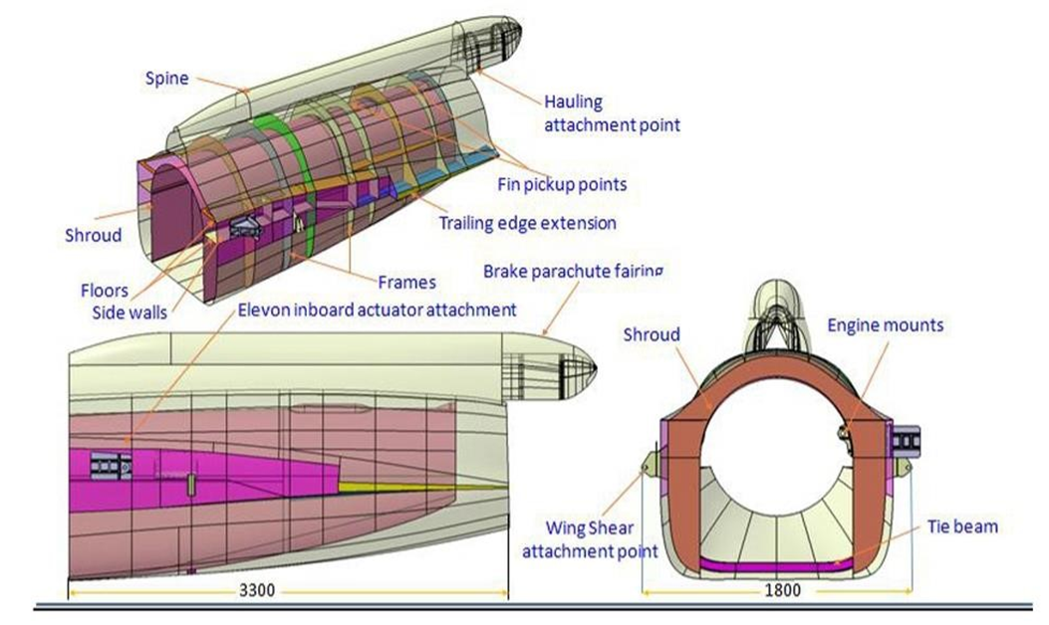
Rear fuselage
Nonlinear 6-DOF Dynamic RCAM Model
2023-2024
8th SEM DEPT OF ECE DR TTIT, KGF

Slide 20
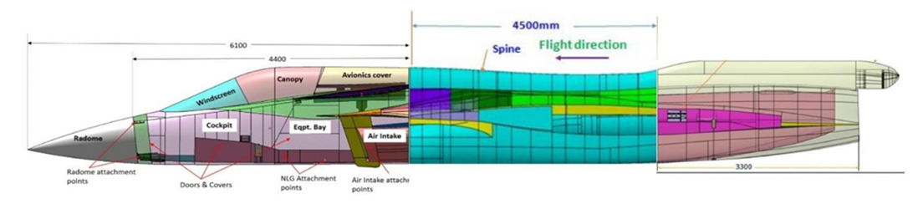
COUPLING
Nonlinear 6-DOF Dynamic RCAM Model
2023-2024
8th SEM DEPT OF ECE DR TTIT, KGF

Slide 21
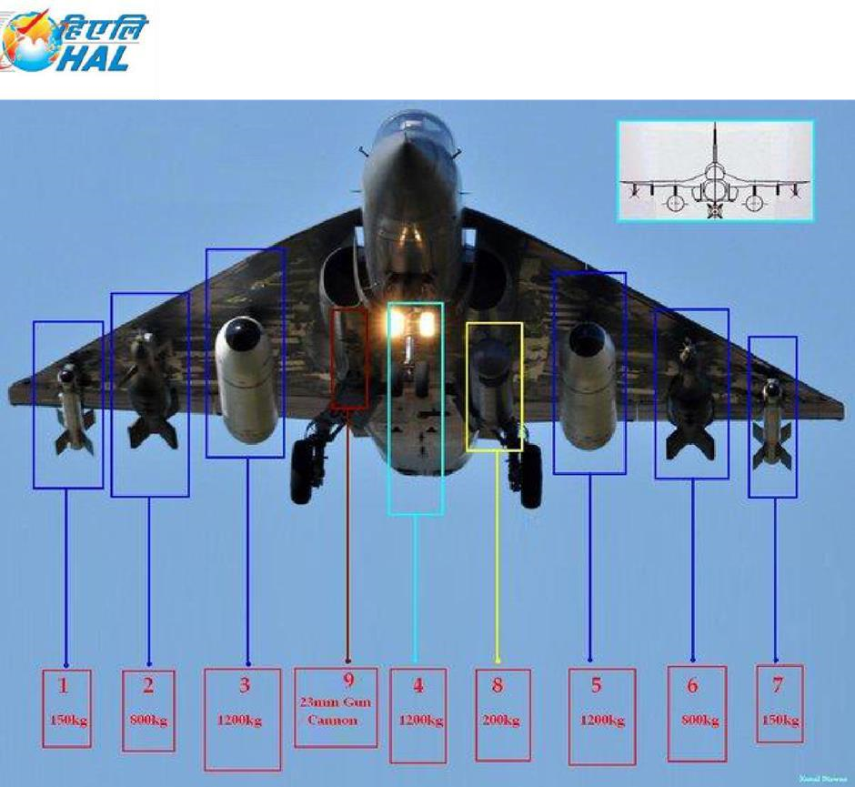
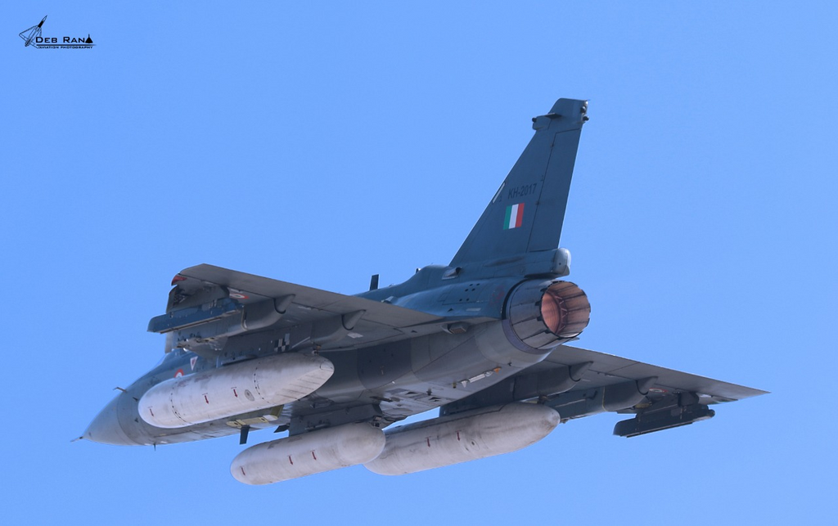
Nonlinear 6-DOF Dynamic RCAM Model
2023-2024
Drop Tanks:
:
8th SEM DEPT OF ECE DR TTIT, KGF

Slide 22
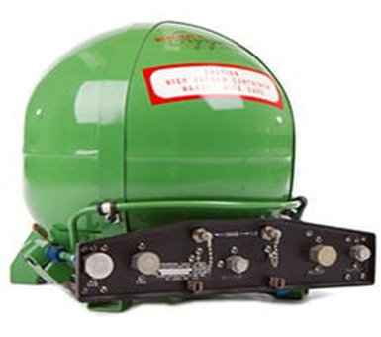
Nonlinear 6-DOF Dynamic RCAM Model
2023-2024
❖Missiles: ❖Oxygen Tank
1. Air to air missiles
Derby
Python 5
R-73
2. Air to Surface missiles
Kh-58
DRDO Anti-Radiation missiles
3. Anti ship missiles
Kh-31
Kh-335
Bombs:
Laser-guide bombs
Glide bombs
Cluster weapons
8th SEM DEPT OF ECE DR TTIT, KGF

Slide 23
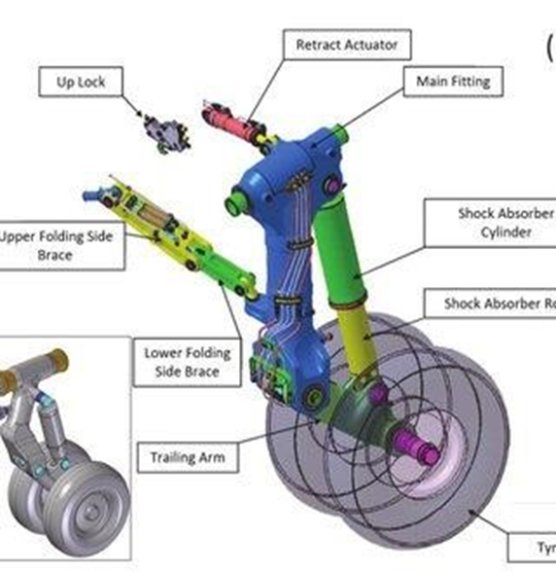
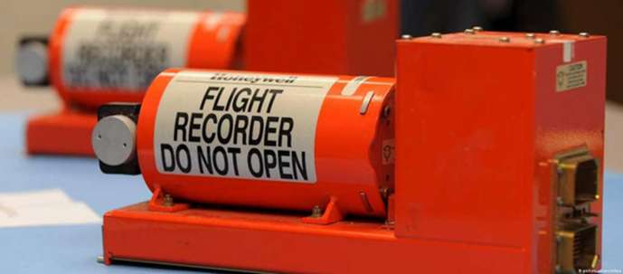
Nonlinear 6-DOF Dynamic RCAM Model
2023-2024
Landing Gear
Black Box [CDR]
8th SEM DEPT OF ECE DR TTIT, KGF

Slide 24
Nonlinear 6-DOF Dynamic RCAM Model
2023-2024
❖Applications:
Air Defense
Training
Combat Air Patrol
Export
Research and Development
8th SEM DEPT OF ECE DR TTIT, KGF

Slide 25
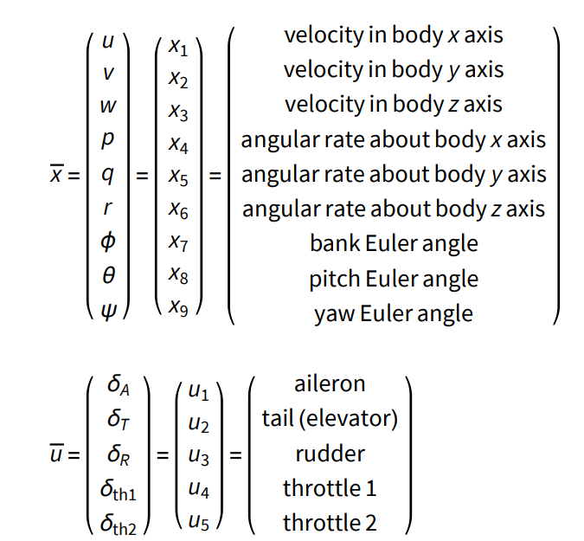
System Implementation :
2023-2024
Nonlinear 6-DOF Dynamic RCAM Model
Nonlinear 6-DOF RCAM model
The RCAM aims to model the behavior of a civil aircraft using a nonlinear, 6-degree-of-freedom (6-DOF) dynamic model.
It provides insights into flight dynamics, control, and stability.
The RCAM is a valuable tool for research, testing, and design optimization.
8th SEM DEPT OF ECE DR TTIT, KGF

Slide 26
Flow Chart for RCAM_model.m
Nonlinear 6-DOF Dynamic RCAM Model
2023-2024
Calculate Aerodynamic Coefficients
Return Xdot
START
Constraints Set-up
Calculate Forces & Moments
STOP
Extract State & Input
Vectors
Calculate State Derivatives
8th SEM DEPT OF ECE DR TTIT, KGF

Slide 27
Flow Chart for Initialization.m
Nonlinear 6-DOF Dynamic RCAM Model
2023-2024
Run RCAM Simulation
START
Initial Setup
Plot Results
Define Constraints
STOP
8th SEM DEPT OF ECE DR TTIT, KGF

Slide 28
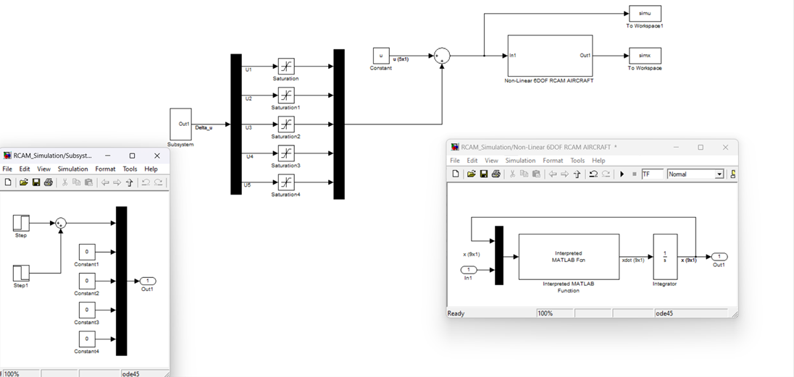
Simulink Design
2023-2024
Nonlinear 6-DOF Dynamic RCAM Model
8th SEM DEPT OF ECE DR TTIT, KGF

Slide 29
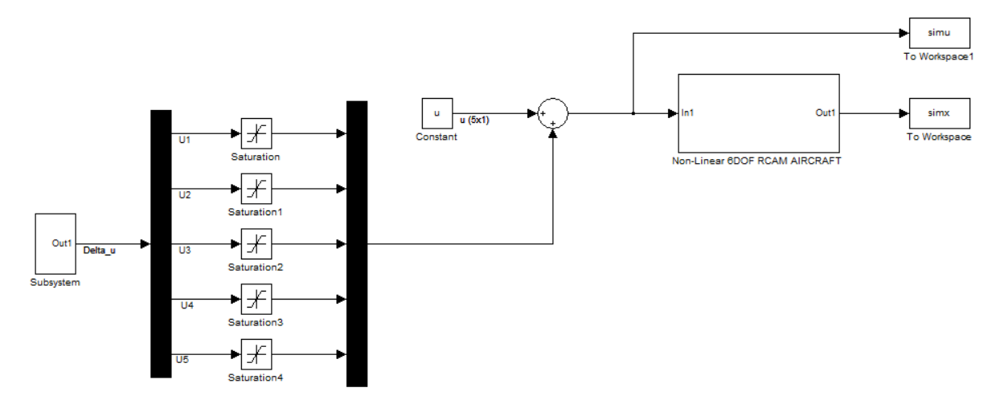
RCAM Simulink Module
Nonlinear 6-DOF Dynamic RCAM Model
2023-2024
8th SEM DEPT OF ECE DR TTIT, KGF

Slide 30
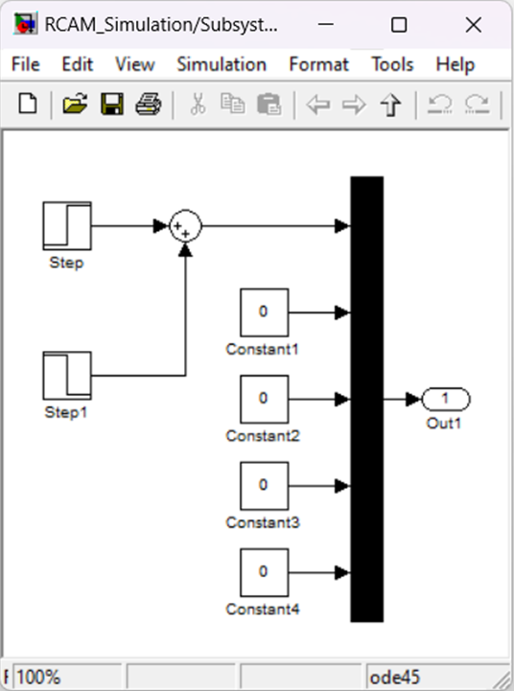
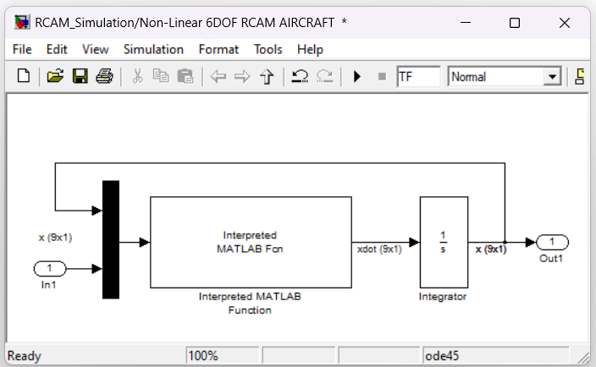
Nonlinear 6-DOF Dynamic RCAM Model
2023-2024
Sub-Systems
U inputs :
Non-Linear 6DOF RCAM AIRCRAFT :
8th SEM DEPT OF ECE DR TTIT, KGF

Slide 31
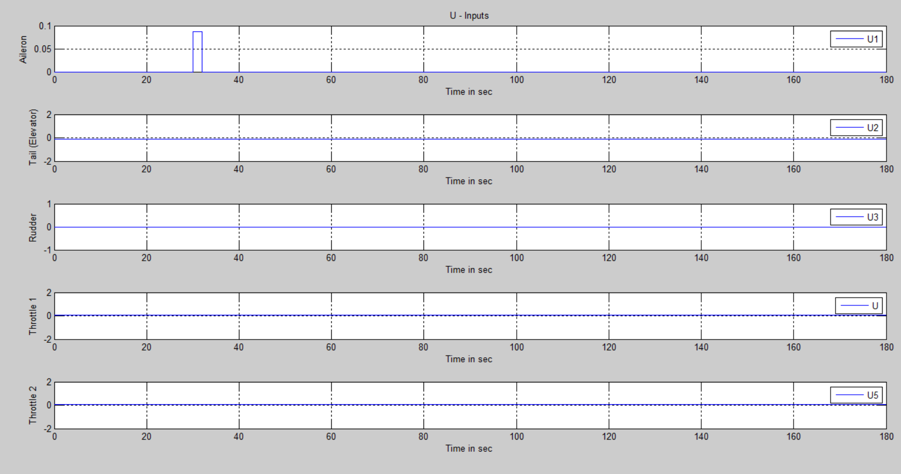
U Inputs
Nonlinear 6-DOF Dynamic RCAM Model
2023-2024
8th SEM DEPT OF ECE DR TTIT, KGF

Slide 32
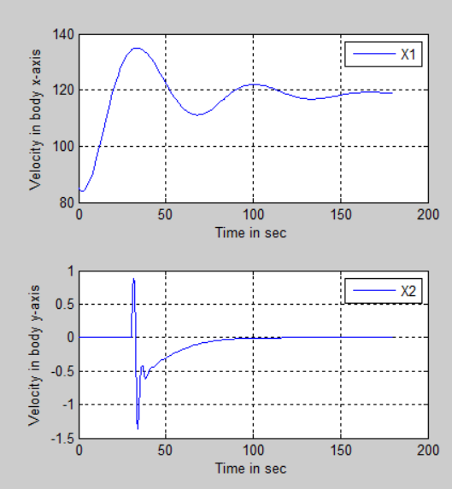
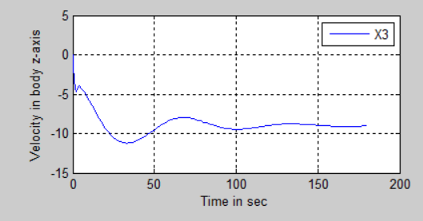
Outputs Waveform For Velocity
Nonlinear 6-DOF Dynamic RCAM Model
2023-2024
8th SEM DEPT OF ECE DR TTIT, KGF

Slide 33
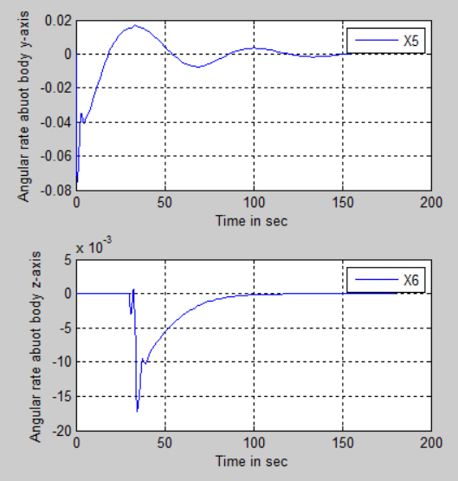
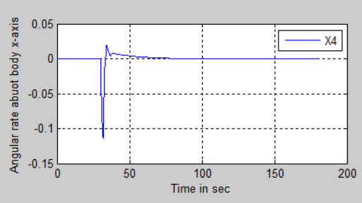
Outputs Waveform For Angular Rate
Nonlinear 6-DOF Dynamic RCAM Model
2023-2024
8th SEM DEPT OF ECE DR TTIT, KGF

Slide 34
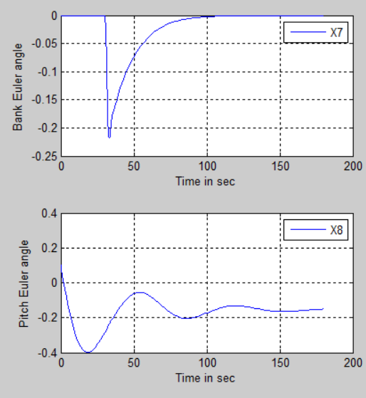
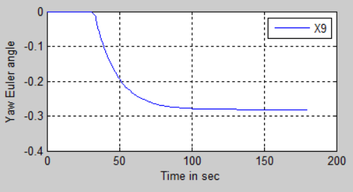
Outputs Waveform For Euler angle
Nonlinear 6-DOF Dynamic RCAM Model
2023-2024
8th SEM DEPT OF ECE DR TTIT, KGF

Slide 35
CONCLUSION
Nonlinear 6-DOF Dynamic RCAM Model
2023-2024
Hindustan Aeronautics Limited (HAL) is renowned globally for its commitment to quality and vast portfolio in aviation technology, including trainers, transporters, combat aircraft, helicopters, aero engines, communication systems, and aerospace equipment.
Our internship at HAL has provided invaluable knowledge and experience, positioning us for successful careers within the aerospace industry.
Our project successfully simulated aircraft dynamics using the Research Civil Aircraft Model (RCAM) model in Simulink
8th SEM DEPT OF ECE DR TTIT, KGF

Slide 36
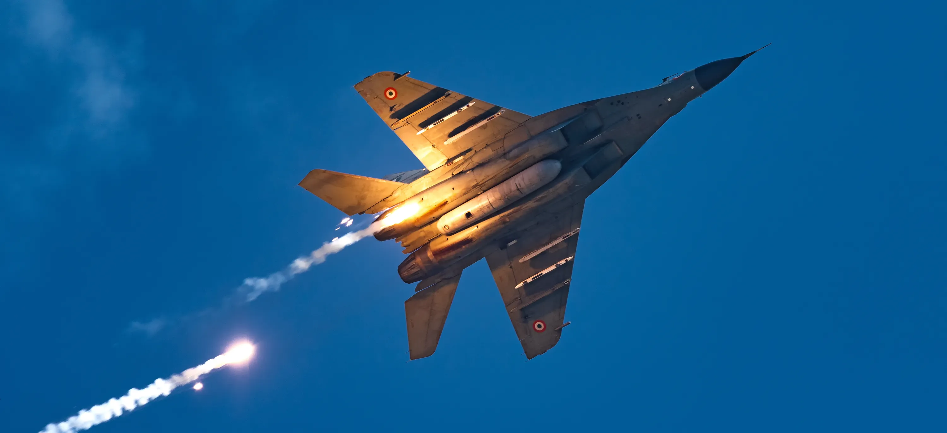
THANK YOU

